Slide 1
North Carolina COVID-19 Vaccine Management System CVMS HCP Onboarding and Recipient Bulk Submission User Guide
Version 1
January 27, 2021

Slide 2
Table of Contents
Pages
COVID-19 Vaccine Helpdesk HCP Onboarding/Recipient Bulk Upload Timeline and Key Terms | 3 – 5
Registering for a ServiceNow Helpdesk Portal Account | 6 – 10
Logging In | 11 - 13
Submitting an HCP Onboarding and Recipient Bulk Upload Form | 14 – 20
Appendix | 21 - 22

Slide 3
COVID-19 ServiceNow HCP Onboarding and Recipient Bulk Upload
Timeline

Slide 4
COVID-19 Vaccine HCP Onboarding/Recipient Bulk Upload Timeline
What is the process your HCP Onboarding and Bulk Upload requests go through and how long does it take?
1
2
3
4
Register and log onto the ServiceNow portal here.
Initiate an HCP Onboarding and/or Recipient Bulk Upload by submitting the appropriate form(s).
When your ticket is submitted, it is sent to a Helpdesk Agent trained to assist you.​
​
The Agent will assess your form(s) and determine if all the necessary information is included and formatted correctly.
If the information is complete and accurate, the desired response times are as follows:
For HCP Onboarding, the Agent should have your Providers provisioned for CVMS HCP Portal access within 2-3 days.
For Recipient Bulk Upload, the Agent should have your Recipients account created for CVMS Recipient Portal access within 48 hours.
Note: if you have not heard back within the desired time-frame, please log-in to your ServiceNow account and check the status of the ticket. We apologize for any response delays and are doing our best to respond to requestors as soon as possible!
Information on how to correct and re-upload the Recipient Bulk Upload template can be found here (Pages 18-23).
If additional corrections/updates are needed, please submit a ticket via the CVMS Helpdesk with the needed corrections included.
You will receive an email when the process is complete.

Slide 5
Key Terms
HCP
Healthcare Providers. Refers to the clinical personnel who will be registered in CVMS to administer vaccinations.
Recipient Bulk Upload
The process of uploading the names of many vaccine recipients at one time through the ServiceNow portal. This will be done if there are individuals you employ and/or are under your purview who need to be vaccinated.
ServiceNow /Helpdesk Portal
Online portal for submitting questions and provider/recipient information related to CVMS. ServiceNow is a separate system from CVMS and requires unique login credentials.
CVMS
COVID-19 Vaccine Management System
HCP User Onboarding
The process of uploading the names of vaccine providers (individuals who will be administering the vaccine) for CVMS provisioning through the ServiceNow portal.

Slide 6
COVID-19 ServiceNow HCP User Onboarding and Recipient Bulk Upload
Registration Process

Slide 7
Step 1 of 11:
1. Go to https://ncgov.servicenowservices.com/cms_vaccine/ to access the CVMS Helpdesk Portal.
Audience
Healthcare Providers

Slide 8
Step 2 of 11:
If this is your first time submitting a ticket via the Helpdesk Portal, you must Register for an account. This can be done by selecting the Register button in the top-right corner of your screen.
Note: This account is specific to the Helpdesk Portal and will require you to create a new account (username and password). This account is NOT related to your CVMS log-in information or your NCID.
If you have already registered for a Helpdesk Portal account, please skip to Step 5 to login.
Audience
Healthcare Providers
Note
This account is specific to the Helpdesk Portal and is NOT related to your CVMS log-in information or your NCID.

Slide 9
Step 3 of 11: Complete Registration Form
Fill out the Customer Registration form.
Then, check the box next to the Terms and Conditions and click Submit.
Note: Your Registration Code is your Provider PIN. It can be found on the packing lists received with your Vaccines For Children shipments, or in the top right-hand corner of a wasted / expired report generated from the North Carolina Immunization Registry (please add “NCA” to the front of the six digit PIN#). If you do not know your Registration Code, please use “VAC2021” as the code.
Audience
Healthcare Providers
Note
If you are planning on submitting HCP Users for multiple locations, please just pick one Registration Code to use for your Helpdesk Portal account. You will be able to submit HCP User Onboarding templates for multiple facilities even though the facilities have different Registration Codes. You can also use the generic “VAC2021” code instead.

Slide 10
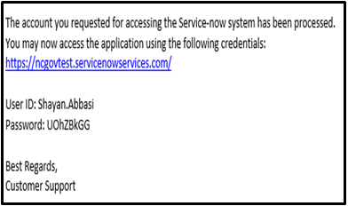
Step 4 of 10: Check Email for Credentials
Audience
You will receive an email (sent to the email address you used in the Customer Registration) from ncgov@servicenowservices.com. This email will contain your username and a temporary password.
See example below.
Healthcare Providers

Slide 11
Step 5 of 11: Navigate to Login Page
Audience
Go back to the Helpdesk Portal (https://ncgov.servicenowservices.com/csm_vaccine. Select Login in the top-right corner.
Healthcare Providers

Slide 12
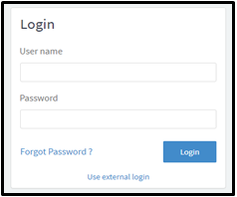
Step 6 of 11: Log In
Login using the Username and Temporary Password that were just emailed to you.
Then, select Login.
Audience
Healthcare Providers

Slide 13
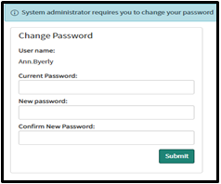
Step 7 of 11: Change Password
If it is your first time logging in, you will be asked to change your password.
Enter your Current Password (the password that was emailed to you) in the first box and enter your New Password in the second and third box.
Then, click Submit.
Audience
Healthcare Providers

Slide 14
Step 8 of 11:
Once you are both registered and logged in, you can select the HCP Onboarding and Recipient Bulk Upload tile on the right side of your screen.
Audience
Healthcare Providers

Slide 15
Step 9 of 11:
When you select the HCP Onboarding and Recipient Bulk Upload, you will be directed to the following screen.
Click anywhere on the field labeled Request Type to see a drop-down menu of request types to choose from. The options are:
HCP User Onboarding: to upload the names/information of medical personnel from a particular facility who will be administering the vaccine. This process will provide access to the Provider Portal to either administer the vaccine to recipients (Providers) or manage vaccine inventory (Location Managers)
Recipient Bulk Upload: to bulk upload individuals who will receive the vaccine. These individuals will need to register in the CVMS Recipient Portal and this process will help provision them for access to the Portal.
Audience
Healthcare Location Manager

Slide 16
HCP User Onboarding Process

Slide 17
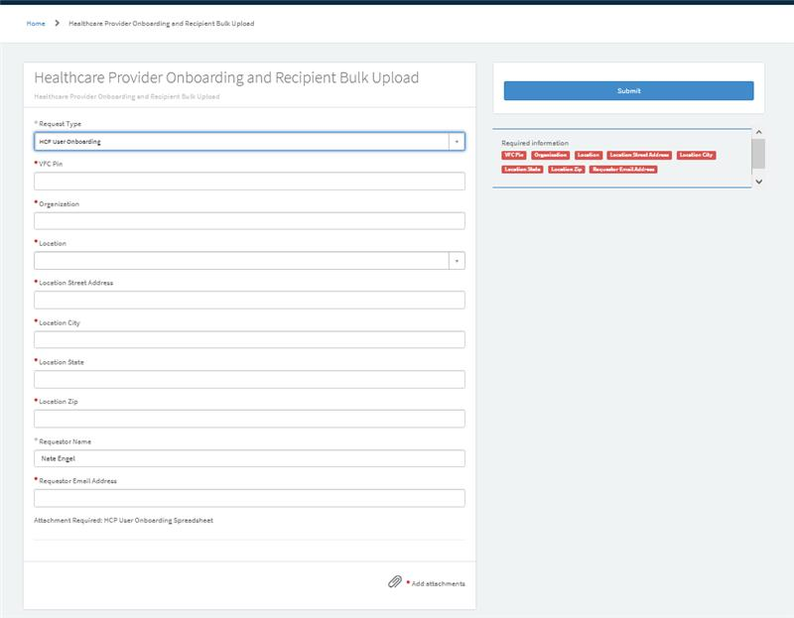
Step 10.1 of 12:
If you select HCP User Onboarding, you will be directed to the screen shown in the image below. Complete the HCP User Onboarding intake form.
Audience
Healthcare Providers
1. Fill in all of the mandatory fields (with the *).
2. Add the appropriate attachment, HCP User Onboarding Spreadsheet, using the Add attachments link at the bottom-right of the form. A template for the document can be found here.
Note: Please ensure to use the template provided and to fill out all of the fields to avoid any delays in processing the file!
Important Note:
The VAC Pin refers to a Vaccine for Children pin number (also know as the Registration Code). If you do not have access to one, use the CVMS vaccination code “VAC2021.” If you are submitting Onboarding files for multiple facilities, you only have to submit one VFC Pin in the form – you are still able to submit forms for different facilities under different VFC Pins. You can also submit multiple files/attachments in the same intake form!

Slide 18
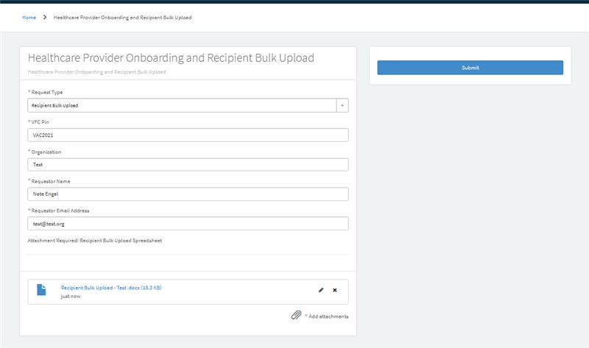
Step 11.1 of 12:
When you have completed all the required fields and attached the required document, your intake form will look similar to the example below.
Submit the form for processing and approval by selecting the blue Submit button in the top-right of the screen.
Audience
Healthcare Providers

Slide 19
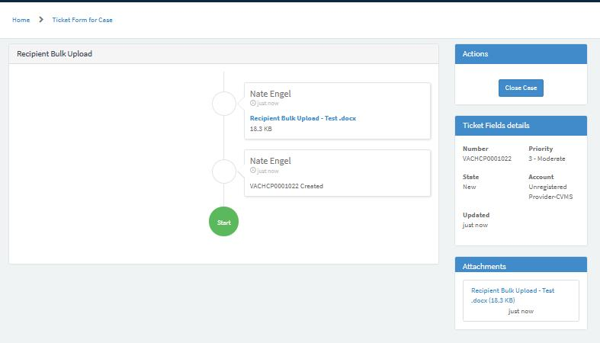
Step 12.1 of 12:
After the ticket submission, you may be brought to the screen shown below. This screen shows you your ticket’s lifespan and will be updated when any updates to your ticket become available.
You should receive your Case Ticket Number and associated notifications via email.
Audience
Healthcare Providers
Note
Following your HCP Onboarding and Recipient Bulk Upload submissions, the HCP user/Recipient will receive an email once they have been provisioned for CVMS access.
The email will include a link to the respective CVMS portal, along with that user’s login credentials to access that portal.
HCP User Onboarding
HCP User Onboarding - Test.docx

Slide 20
After your ticket is submitted…
1. Instantly
2. Same day
Audience
You will be brought to the screen shown below. This screen shows you your ticket’s lifespan and will be updated when any updates to your ticket become available.
You should receive your Case Ticket Number and associated notifications via email.
Healthcare Providers
3. Within 2-3 business days
When the users included in the file have been provisioned for CVMS access, they will receive an email informing them of such and providing them with the link to the respective portal and their login credentials.
Note: If you have not received an email in 2-3 business days, feel free to submit a helpdesk ticket to request an update. Most likely, there is no problem with the submission and the approval is just delayed, but it doesn’t hurt to check!
Important Note:
If there are any errors with the onboarding file, the ticket will be reopened and you will receive an email and will need to log back into your Helpdesk Portal account to respond and update the file.
HCP User Onboarding
HCP User Onboarding
HCP User Onboarding - Test.docx

Slide 21
Recipient Bulk Upload Process

Slide 22
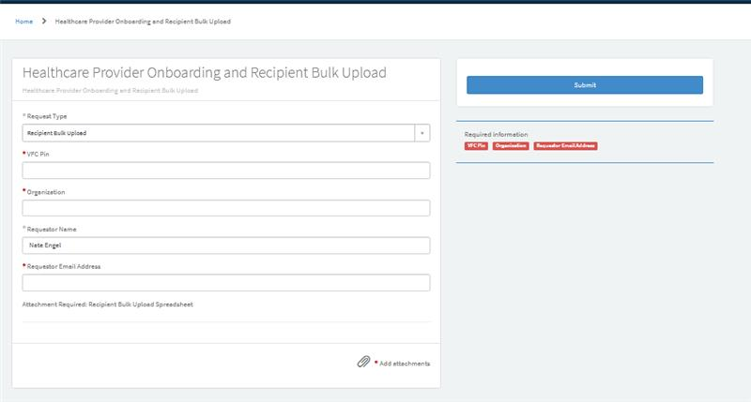
Step 10.2 of 12:
If you Complete the Recipient Bulk Upload intake form.
Audience
1. Fill in all of the mandatory fields (with the *).
2. Add the appropriate attachment, Recipient Bulk Upload Spreadsheet, using the Add attachments link at the bottom-right of the form. A template for the document can be found here.
Note: Please ensure to use the template provided and to fill out all of the fields to avoid any delays in processing the file!
Healthcare Providers
Tips
Check for file errors.
Instructions on how to correct and re-upload the Recipient Bulk Upload template: Recipient Bulk Upload User Guide (Pages 18-23) located on the NC Immunization Branch – COVID-19 Training Site.

Slide 23
Step 11.2 of 12:
When you have completed all the required fields and attached the required document, your intake form will look similar to the example below.
Submit the form for processing and approval by selecting the blue Submit button in the top-right of the screen.
Audience
Healthcare Providers

Slide 24
Step 12.2 of 12:
After the ticket submission, you may be brought to the screen shown below. This screen shows you your ticket’s lifespan and will be updated when any updates to your ticket become available.
You should receive your Case Ticket Number and associated notifications via email.
Audience
Healthcare Providers
Note
Following your HCP Onboarding and Recipient Bulk Upload submissions, the HCP user/Recipient will receive an email once they have been provisioned for CVMS access.
The email will include a link to the respective CVMS portal, along with that user’s login credentials to access that portal.

Slide 25
After your ticket is submitted…
1. Instantly
2. Same day
Audience
You will be brought to the screen shown below. This screen shows you your ticket’s lifespan and will be updated when any updates to your ticket become available.
You should receive your Case Ticket Number and associated notifications via email.
Healthcare Providers
3. Within 2-3 business days
When the users included in the file have been provisioned for CVMS access, they will receive an email informing them of such and providing them with the link to the respective portal and their login credentials.
HCP User Onboarding
Note: If you have not received an email in 2-3 business days, feel free to submit a helpdesk ticket to request an update. Most likely, there is no problem with the submission and the approval is just delayed, but it doesn’t hurt to check!

Slide 26
Appendix

Slide 27
Additional Notes
Key Items:
Hyperlinks appear as light blue and will provide additional information or navigation.
* Asterisks are used to denote required information.
A Toggle can be clicked to see selectable options.
A Pen can be clicked to make edits to the field.
Navigation Buttons can be clicked on to progress to the “next” or the “previous” step in a task.
A Pause button can be clicked if you wish to step away / and return to your form later. You will be prompted to review your previously entered data upon your return/ login.
Questions:
For frequently asked questions and answers, visit Knowledge Home - CVMS Vaccine Support (servicenowservices.com).
Supported Web Browsers:
Please use the latest version of Chrome, Firefox, Safari, or Edge Chromium browsers to access CVMS.
For more information on supported browsers, see https://help.salesforce.com/articleView?id=getstart_browsers_sfx.htm&type=5
Note: Internet Explorer and Edge (Non-Chromium) are not supported.

