Slide 1
North Carolina COVID-19 Vaccine Management System How to Submit a Ticket through the CVMS Help Desk Portal – Recipient User Guide
Version 1
January 27, 2021

Slide 2
Table of Contents
Pages
CVMS Help Desk Portal Ticket Journey | 3 – 4
Submit a Ticket in the CVMS Help Desk Portal | 5 – 12
Appendix | 13 – 15

Slide 3
CVMS Help Desk Portal Ticket Journey

Slide 4
CVMS Help Desk Portal Ticket Submission Journey and Timeline
What happens when you submit a ticket and how long until you receive a response?
1
2
3
4
Submit a ticket in reference to your CVMS-related question or issue through the CVMS Help Desk Portal at https://ncgov.servicenowservices.com/csm_vaccine
Your submitted ticket is received and reviewed by a Help Desk Agent trained to assist you.
The Help Desk Agent will assess your question or issue and determine the necessary helpful resources.
Within 1 to 2 business days, the Help Desk Agent will respond to your ticket with a proposed resolution or with a request for more information from you to help accurately triage and resolve your inquiry.
You can respond to the email with any requested additional information.
You will be notified via email from ncgov@servicenowservices.com
If you have any additional questions following the Help Desk Agent’s response, you may reply to the email within 8 days or submit a new ticket.
If we receive no response from you after 8 days, your ticket is closed.
You may submit additional tickets at any time.

Slide 5
Submit a Ticket in the CVMS Help Desk Portal

Slide 6
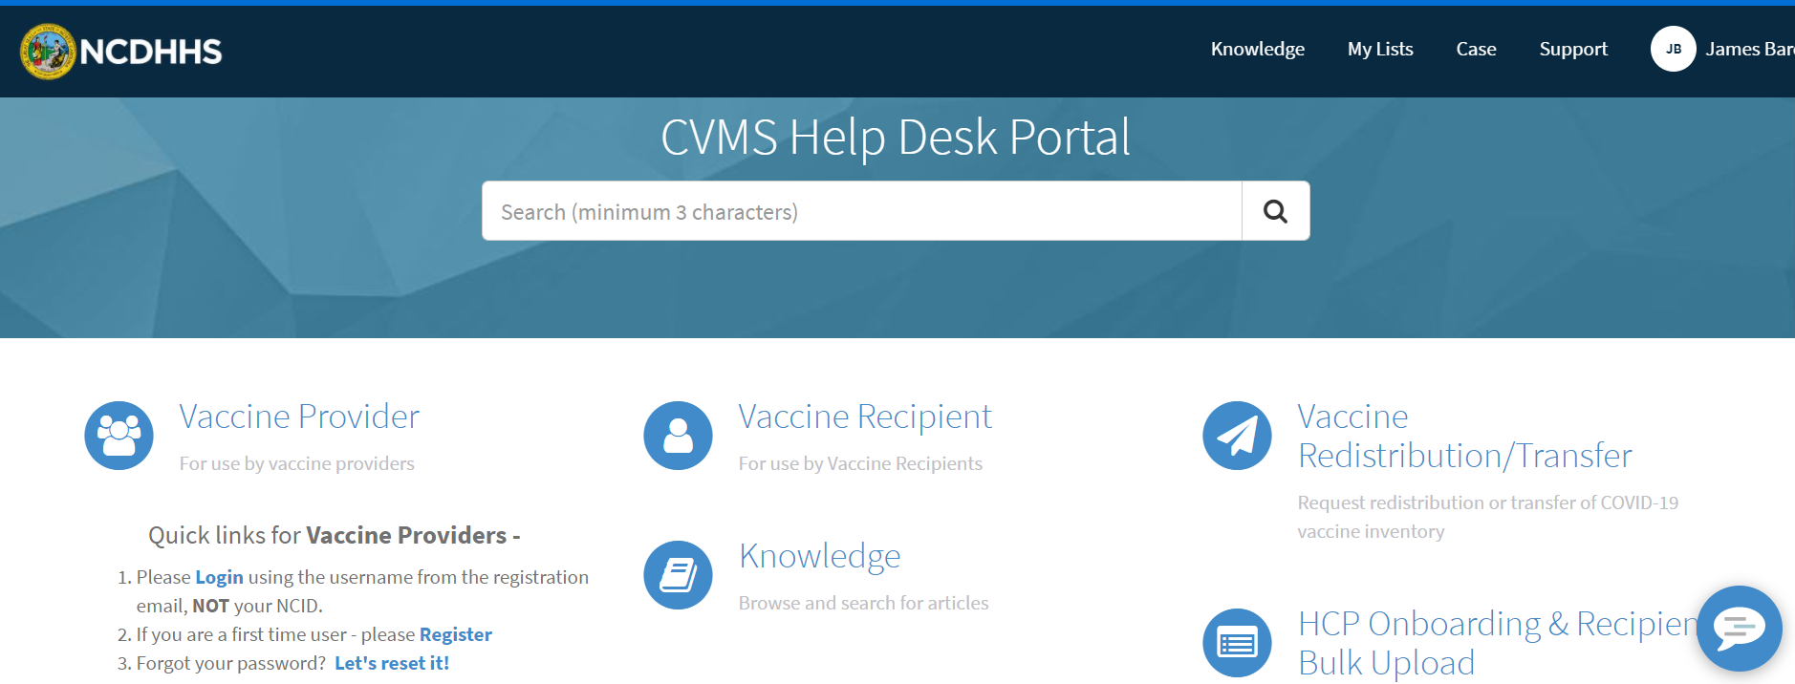
Step 1 of 7: Navigate to Website
Note: A “Vaccine Recipient” is anyone who is planning to receive (or has already received) the COVID-19 vaccine.
Go to https://ncgov.servicenowservices.com/csm_vaccine to access the CVMS Help Desk Portal.
Select the Vaccine Recipient option. This will direct you to the Vaccine Recipient intake form.
Audience
Vaccine Recipients
Note
Vaccine Recipients do not need to Register or Login to the CVMS Help Desk Portal to submit a ticket.

Slide 7
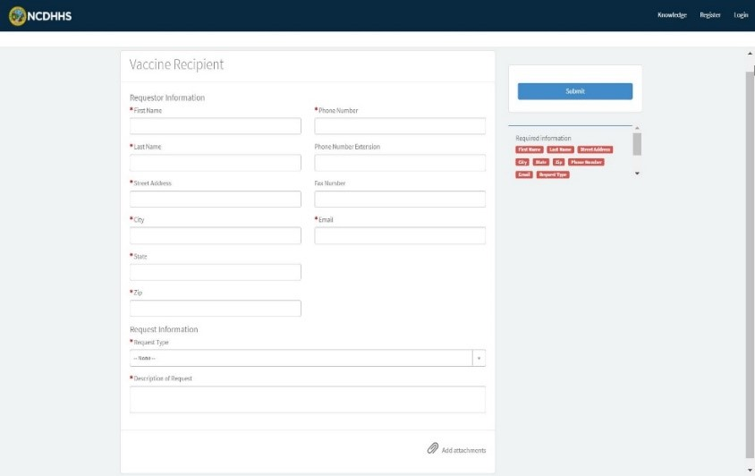
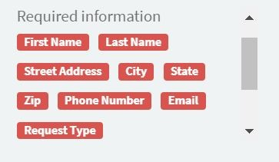
Step 2 of 7: Complete Requestor Information
After selecting Vaccine Recipient, you will see the Vaccine Recipient intake form.
The top portion of the intake form is for your Information. As the ticket creator, you can type your personal information into the designated fields.
Audience
Vaccine Recipients
Note
This information is to provide the Help Desk Agent with sufficient information to provide the recipient an answer to their question and/or to contact the recipient with any follow-up info necessary.
This information is private and will not be shared with anyone outside of the CVMS Help Desk.
All the fields starred with a red asterisk (*) are required and the page will not allow you to submit the ticket without completing each required field. A list of red words on the right side of the screen will serve to remind you of any required fields that are still incomplete.

Slide 8
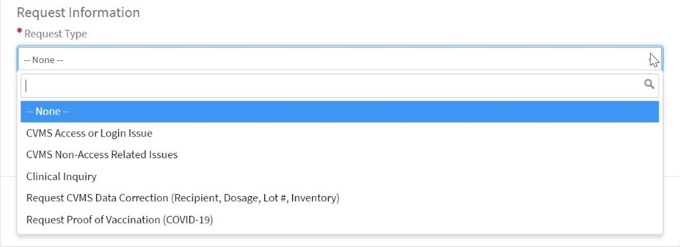
Step 3 of 7: Complete Request Information
Audience
The lower portion of the intake form is for Request Information. Here is where you specify the type of inquiry you have.
Vaccine Recipients
Note
See the Appendix for more details about the Request Type drop-down menu items.
Under Request Type, use your cursor to click anywhere in the box that currently says “—None—”. Doing so will activate a drop-down menu of request types to choose from.

Slide 9
Step 4 of 7: Provide Request Details
Audience
In the field labeled Description of Request, go into more detail about your request so that the Help Desk Agent can provide you with the most accurate support.
Vaccine Recipients

Slide 10
Step 5 of 7: Add Attachments
To add additional documents that may clarify your request (for example a screenshot of your issue), select Add attachments in the bottom right corner of the intake form.
Audience
Vaccine Recipients
Note
This step is not required for submission, if not applicable.

Slide 11
Step 6 of 7: Submit
Once the vaccine recipient Help Desk ticket form is completed, you can select the Submit button on the right side of your screen.
Audience
Vaccine Recipients

Slide 12
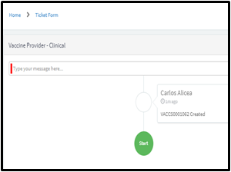
Step 7 of 7: Receive Ticket Submission Confirmation
You should receive your ticket number and associated notifications via email.
After the ticket submission, you may be brought to the screen shown below. This screen shows you your ticket’s lifespan and will be updated when any updates to your ticket become available.
Audience
Vaccine Recipients

Slide 13
Appendix

Slide 14
Additional Notes
Key Items:
Hyperlinks appear as light blue and will provide additional information or navigation.
* Asterisks are used to denote required information.
A Toggle can be clicked to see selectable options.
A Pen can be clicked to make edits to the field.
Navigation Buttons can be clicked on to progress to the “next” or the “previous” step in a task.
A Pause button can be clicked if you wish to step away / and return to your form later. You will be prompted to review your previously entered data upon your return/ login.
Questions:
For frequently asked questions and answers, visit Knowledge Home - CVMS Vaccine Support (servicenowservices.com).
Supported Web Browsers:
Please use the latest version of Chrome, Firefox, Safari, or Edge Chromium browsers to access CVMS.
For more information on supported browsers, see https://help.salesforce.com/articleView?id=getstart_browsers_sfx.htm&type=5
Note: Internet Explorer and Edge (Non-Chromium) are not supported.

Slide 15
Request Type Information
Here is more detail about the Request Type drop-down menu items:
CVMS Access or Login Issue: Use if you are unable to log in to CVMS due to forgotten username, password, linked email address, etc., or for other access issues.
CVMS Non-Access Related Issues: Use if you are facing a CVMS issue beyond not being able to login/access CVMS.
Clinical Inquiry: Use if you have a request regarding vaccine administration, side effects, or other question to be answered by a trained clinician.
Request CVMS Data Correction (Recipient, Dosage, Lot #, Inventory): Use if some element within your CVMS account is incorrect and needs to be updated.
Request Proof of Vaccination (COVID-19): Use if you would like to request proof that you have received a COVID-19 vaccine.

