Slide 1

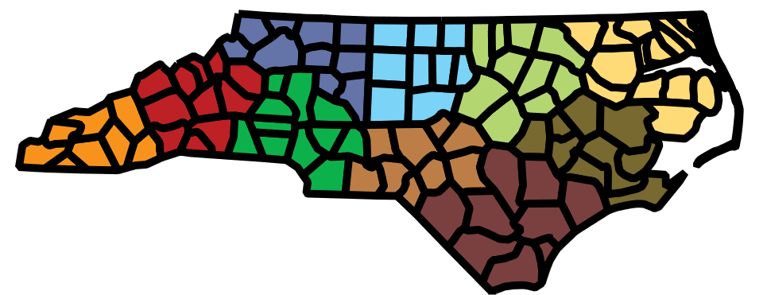
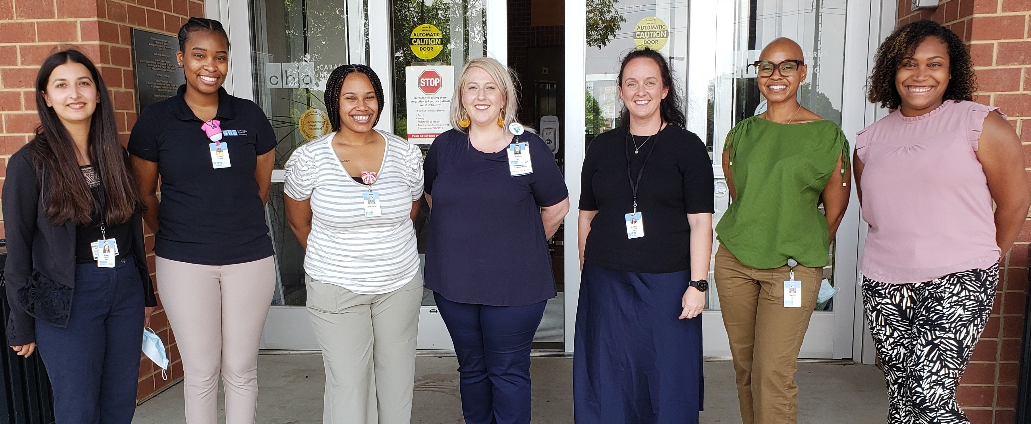

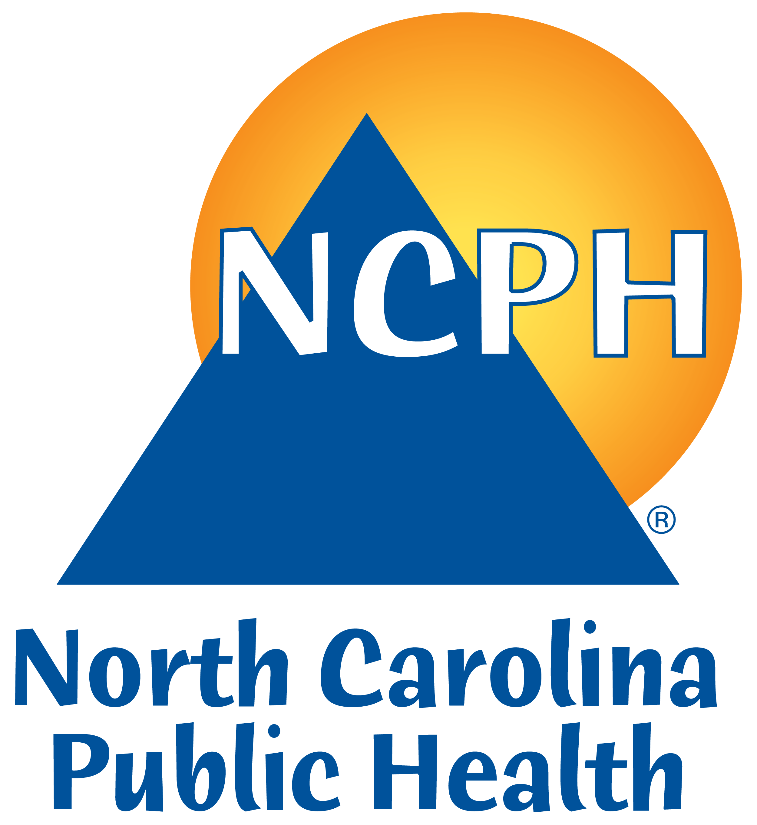
Robust infection prevention practices are the backbone for preventing the spread of disease. Strengthening infection prevention capacity through training, education, and consultation in post-acute care settings while enhancing the ability of public health to work with these settings will serve to reduce disease introduction and transmission and make for a healthier population.
Established in August 2020, the Regional Infection Prevention Support Teams (RIPSTs) are placed in each of North Carolina’s 10 public health regions to provide on-site infection prevention and control assistance, training, and consultation to all types of post-acute care facilities, particularly those facility types that do not have trained medical staff. Under the guidance of the Division of Public Health, these Teams will use evidence-based infection control procedures consistent with applicable CDC, CMS and HHS guidance to bolster infection prevention knowledge and practices, mitigating and preventing health threats like COVID and all other infectious diseases, thereby reducing morbidity and mortality.
RIPSTs offer:
Infection prevention and control assistance that is not regulatory or punitive
Staff training/education around infection prevention measures (including vaccination education)
Consultation
RIPSTs have:
Made initial contact with >3800 post-acute care facilities
Completed over 2100 in-person visits
Provided in-person vaccination education sessions
Assisted with vaccination distribution planning and implementation
Assisted with outbreak management and response
Stakeholder feedback:
Every part of the visit was helpful.
Everything was well explained.
The visit was helpful because I got an understanding of what needed to be done as well as reassurance about procedures that were definitely working.
Very knowledgeable; helpful. Handouts given/shared.
The RIPS team was just so thorough. They were so knowledgeable and very pleasant. They explained everything so well.
Always great to have another set of eyes to see the full picture. Excellent handouts and posters.
The visit was so informative, and the RIPS team was personable, understanding, and easy to work with.
Knowing that there is a resource for the community to reach out to when needed is very helpful.
This is a service funded through the federal CARES Act, through NCDHHS. Facilities should receive a letter of introduction and phone call from the RIPS team covering their respective region. If you have questions about these teams or would like to connect with the team in your region, please contact:
Caroline Colburn, RIPS Team Coordinator
NC Department of Health and Human Services
Division of Public Health, Communicable Disease Branch
caroline.colburn@dhhs.nc.gov • 919.737.4548

